Slide 1
Week 3 progress

Slide 2
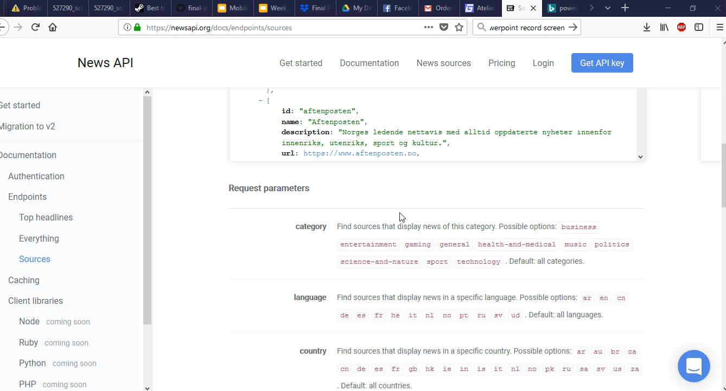
Demo

Slide 3
What we have done
Robert: Refactored Menu events to work with with the new api, changed Navigation view menu to dynamic based on the News categories based on the API
Chirs: refactored article and source methods to use version 2 of newsapi and take optional arguments and added everything query, run query with a search word and get all articles with said topic
Jacob: Set up user registration for firebase and made registration and sign in buttons

Slide 4
What needs to be done
Need to run query to get categories instead of hard coding.
Make a search bar to search for topics.
Add user account Page
Finish history DB

